Slide 1
LT: I can analyze trends in the population growth and distribution of Luxembourg, France, and Bosnia and Herzegovina .
November 20, 2015

Slide 2
WOTD AND QOTD:
WOTD:
Infrastructure: basic structures and facilities (buildings, roads, & power supplies) needed for the operation of a society.
QOTD:
Do you think most of the countries in Europe are developed or developing? Please explain why.

Slide 3
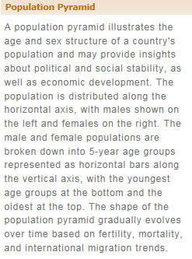
Population Pyramids: Review

Slide 4
Lets Practice: PowerUp!
You are going to use slides 5-7 from the PowerPoint on the HUB to complete a population pyramid for three European countries.
Please pay close attention to data and the instructions!

Slide 5
France

Slide 6
Luxembourg

Slide 7
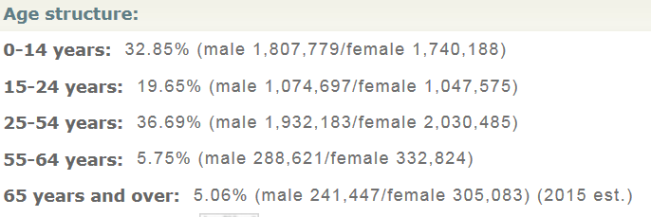
Bosnia and Herzegovina

Slide 8
Applying our Data
Now you will need to use the data from your population pyramids in addition to the review information from the following slides to answer questions 1-6 on your handout.
Use your time wisely!

Slide 9
Economic Indicators: Review
These factors affect populations and help determine their HDI ranking.

Slide 10
Double Check Your Work
Use the population pyramids on slides 11-13 to double check your response to question number 1. Do you need to make any corrections?

Slide 11
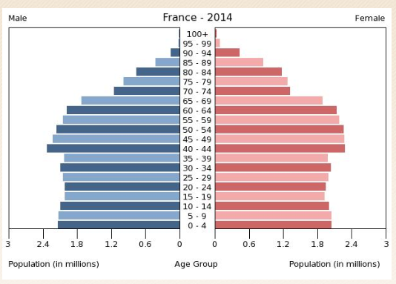
France

Slide 12
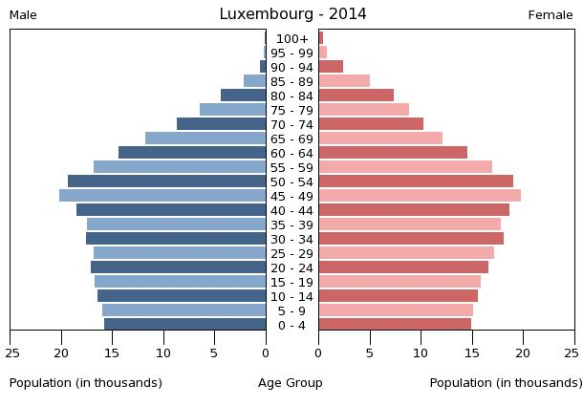
Luxembourg

Slide 13
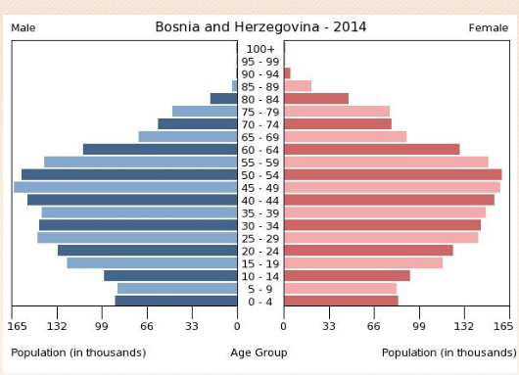
Bosnia and Herzegovina

Slide 14
Exit Ticket
How is Europe different from the “New World” (the Americas) so far?

