Slide 1
November 5, 2015 I can sketch a map of South America and explore its natural resources.

Slide 2
Word of the Day
WebQuest= a lesson in which most or all the information that learners work with comes from the web.

Slide 3
Question of the Day
Name one country in South America.
What is the culture of South America like?

Slide 4
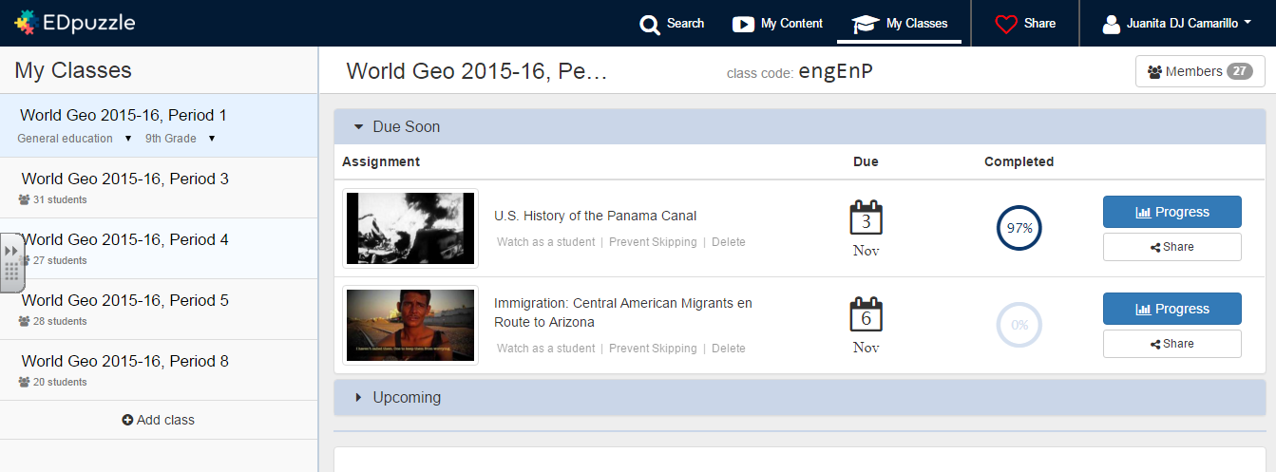
Central America Articles
Snapshot Corrections
EdPuzzle.com
Immigration: Central American Migrants en Route to Arizona

Slide 5
Intervention Forms
11/06/15
67
O 4 Spheres

Slide 6
About South America… Languages

Slide 7
About South America: GDP!

Slide 8
About South America. Land Use & Resources.

Slide 9
About South America, Exports.

Slide 10
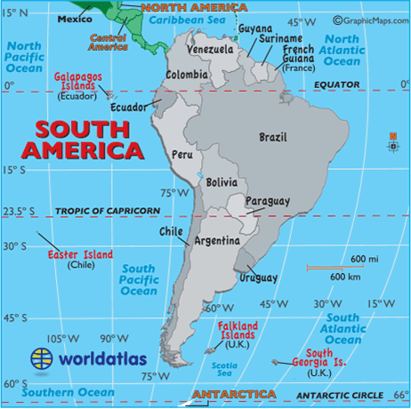
Fast Five Filming in Rio (~3 min’s)
;)
https://www.youtube.com/watch?v=OKVuuMQOJbU

Slide 11
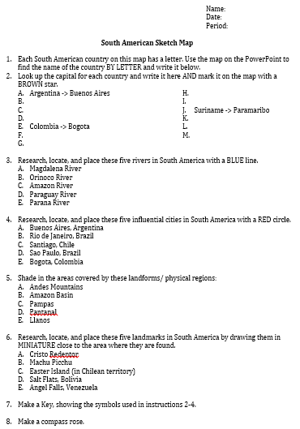
Today!

Slide 12
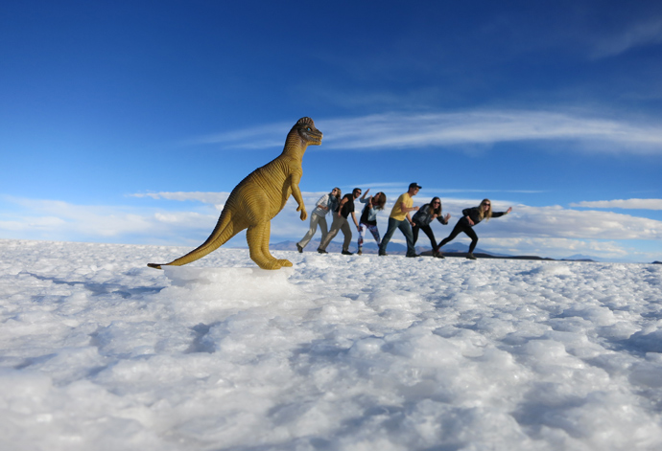
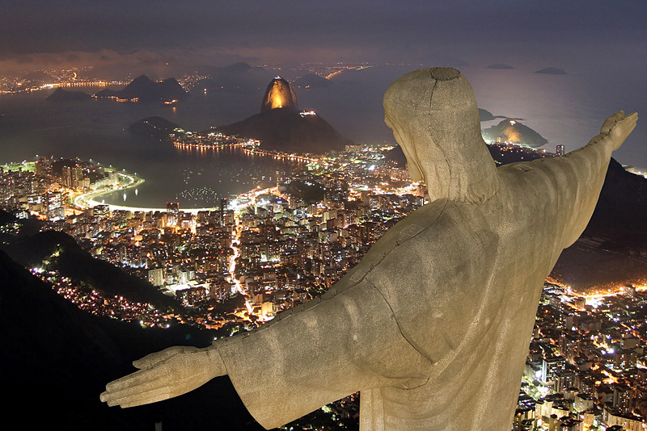
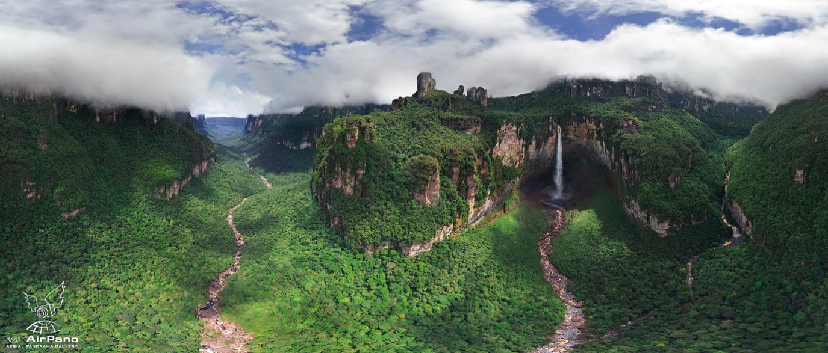
☺

Slide 13
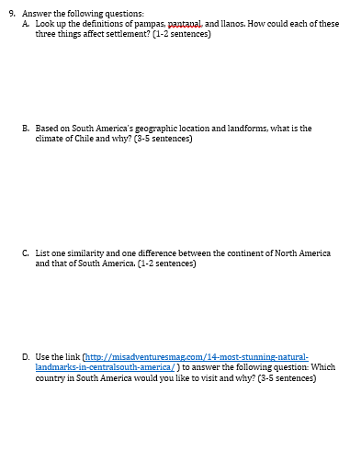
Today!
Due Friday, 11/13/15

Slide 14
Due Friday, 11/13/15

Slide 15
PowerUp!
Sclarkegeo.weebly.com
Third Six Weeks
South America WebQuest

Slide 16
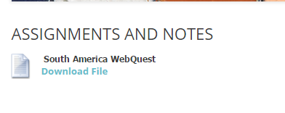

Slide 17
Houstonisd.org/hub
Courses: S1 ESL W Geo
South American WebQuest

Slide 18
Due Friday, 11/13/15

Slide 19
Power down, please.

Slide 20
Exit Ticket
Why do I know a lot about Brazil and only a little about Guyana?

