Slide 1
11.09.15 I can identify characteristics of population growth and distribution in Argentina, Bolivia, and Guyana.

Slide 2
Word of the Day
Per Capita GDP: the average income of people in a country (not an accurate number).

Slide 3
Question of the Day
Why is a population pyramid important?

Slide 4
Pyramid review
This is a way to measure the population distribution of a country.
It is broken up by male and female and usually in 5 year intervals.
It allows us to see how a country is structured and allows a government to plan for resources.

Slide 5
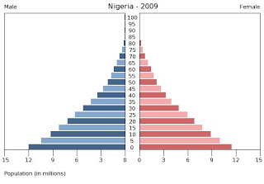
3 Types of pyramids
Rapid Growth Population Pyramid
Looks like a typical pyramid with a large base that gets smaller as you ascend.
What types of advantages or challenges can you predict for countries with this type of growth?

Slide 6
Odd man out..
Who would you see the most of with Rapid Growth Pyramid

Slide 7
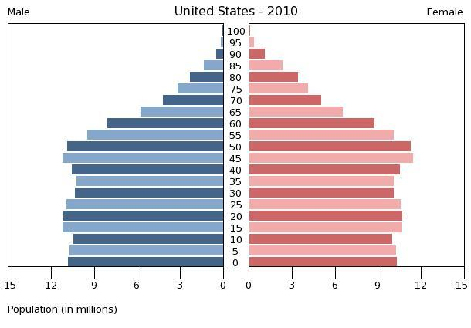
3 Types of pyramids
Slow or Stable Growth Population Pyramid
There is little change in the lower sections of the pyramid.
What types of advantages or challenges can you predict for countries with this type of growth?

Slide 8
Odd man out..
Who would you see the most of with a Slow or Stable Growth Pyramid

Slide 9
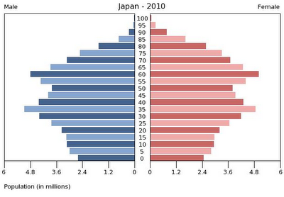
3 Types of pyramids
Negative or Declining Growth Population Pyramid
The top third and bottom third are both smaller than the middle section of the pyramid.
What types of advantages or challenges can you predict for countries with this type of growth?

Slide 10
Odd man out..
Who would you see the most of with a Slow or Stable Growth Pyramid

Slide 11
Practice what you know
You are now going to make 3 pyramids for South American countries based on what you remember have learned.
Power up
Go to the CIA world fact book
Search the following 3 countries and look under people and society
Argentina
Bolivia
Guyana

Slide 12
Lesson E.Q.
Would you classify Argentina as a stable, rapid or declining growth population? Why?

