Slide 1
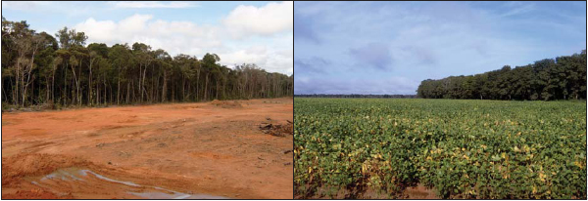
South America: Land Use in the Amazon
How does culture impact ideas on land use?

Slide 2
November 13, 2015
We will be able to evaluate aspects of culture that influence land use in the Amazon region of South America.

Slide 3
Word(s) of the Day
Land Use – the management and/or modification of a natural environment for personal benefit.
Deforestation – the gradual removal of plants and trees from forested areas.
Point of View – a particular view or way of looking at a matter/event.

Slide 4
QOTD
What makes South America different from North and Central America?
Consider the resources, economic activity, standard of living, and use of land in each region.

Slide 5
Activity
Today, we’re going to be gathering our notes using the placards outside.
You are responsible for filling out the bubbles (What do I want) as well as answering all 4 questions for each. This is due at the end of the period.
Keep in mind, there are classes going on all around us. If it gets to be too loud, you will be moved back into the classroom and those responsible with get zeros for this assignment.
Multiple classes will be outside. Be patient.

Slide 6
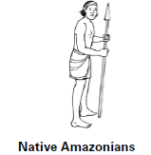
Native Amazonians
The Native Amazonians have lived in the rainforests for about 12,000 years.
They hunt, fish, and grow crops on small plots of land they clear. When a field is no longer fertile (suitable for growing crops), they clear a new area of land and leave the old one to recover.
The Native Amazonians want the government to make them the legal owners of their homeland. They argue that their people have lived in the forests for 12,000 years and use that they use the resources in a sustainable (responsible/replaceable) way.

Slide 7
Rubber Tappers
The Rubber Tappers first came to the Amazon in the 1870’s to work on the rubber tree plantations.
The Rubber Tappers remove sap from the rubber trees by making cuts in the bark, which does not harm the tree.
The Rubber Tappers want to be able to make a living. They want the government to set up protected areas where they can continue to tap rubber. They argue that they have lived in the rainforest for generations and use its resources in a sustainable (responsible/replaceable) way.

Slide 8
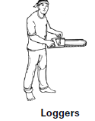
Loggers
Loggers began moving into the Amazon basin in the 1960’s.
Loggers harvest trees for a variety of uses; some of which are making furniture and/or paper products.
Loggers want to continue clear cutting in the rainforest to harvest the trees. Loggers argue that their companies provide jobs thousands of Brazil’s poor. In fact, Brazil exported nearly 5 billion dollars worth of wood in 2004. Loggers argue that their industry helps Brazil’s economy.

Slide 9
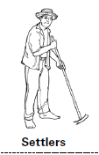
Settlers
In the 1960’s, the Brazilian government began encouraging poor people to move to the Amazon rainforest.
The settlers cleared the land and used it for farming.
Settlers want the land to farm and feed their families. They argue that farming in the rainforest is difficult, but the best farmland in Brazil is already owned by others. They argue the government gave them the land and encouraged them to relocate there.

Slide 10
Cattle Ranchers
Cattle Ranchers came to parts of the Amazon basin beginning in the 1960’s.
Cattle Ranchers clear the land, or use land already cleared by the loggers and farmers, for grazing their cattle. Their cattle eat the grass down to the dirt and then move to a fresh area.
Cattle Ranchers want large tracts (areas) of rainforest land so they can continue cattle ranching. They argue they are making good use of the land and that the cattle they raise helps feed people in Brazil. They export over one billion dollars of beef to the United States yearly to help the Brazilian economy.

Slide 11
Environmental Groups
Scientists and Environmentalists started coming to the rainforest in the 1970’s.
Some scientists and environmentalists study the plants, hoping to find cures for diseases. Others study wildlife or work with the native peoples of the Amazon.
The Environmental Groups want to protect the biodiversity of the rainforest by slowing down deforestation (removal of trees) and development. The Amazon is home to hundreds of different types of trees and thousands of plant and animal species. Once they are gone, they are lost forever.

Slide 12
Exit Ticket – Complete the following statements:
The point of view I most strongly support is the _______________ because _________________ and __________________________ .
The point of view I most strongly oppose is the _______________ because _________________ and __________________________ .

