Slide 1
November 23, 2015 We will be able to compare and contrast the EuroZone and NAFTA.

Slide 2
Word of the Day
European Union: a political and economic union of 28 member states that are located primarily in Europe.

Slide 3
Question of the Day
Are two ALWAYS better than one? Think of a situation when this could be TRUE and one when this could be proven FALSE, please.

Slide 4
Final Exam Schedule
1st pd & 2nd pd Finals: Tuesday, December 15, 2015
3rd pd & 4th pd Finals: Wednesday, December 16, 2015
5th pd & 6th pd Finals: Thursday, December 17, 2015
7th pd & 8th pd Finals: Friday, December 18, 2015
Write this in your calendar!

Slide 5
Due?

Slide 6
European Population Pyramids
Due Tues, 12.01.15

Slide 7
France- 5 min’s

Slide 8
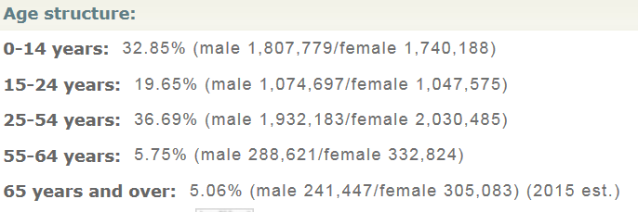
Bosnia and Herzegovina- 5 min’s

Slide 9
Luxembourg- 5 min’s

Slide 10
European Population Pyramids

Slide 11
CFU (Check for Understanding)
How is Europe different from the “New World” (the Americas) so far?

Slide 12
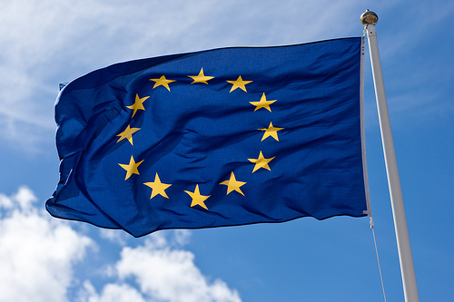
Today!
The EuroZone
But first…
The European Union
https://www.youtube.com/watch?v=XgnXwrsMBUs

Slide 13
Today!
The EuroZone
But first…
The European Union (https://www.youtube.com/watch?v=XgnXwrsMBUs)
Was the European Union always known by this name?
Is ALL Europe part of the European Union?
Is the European Union ONLY an economic union?
What is the currency of the European Union?
Does everyone LIKE the European Union?

Slide 14
The MOST Important things about the European Union…
Countries pay membership dues.
Countries vote on laws.
Citizens of countries are EU citizens.

Slide 15
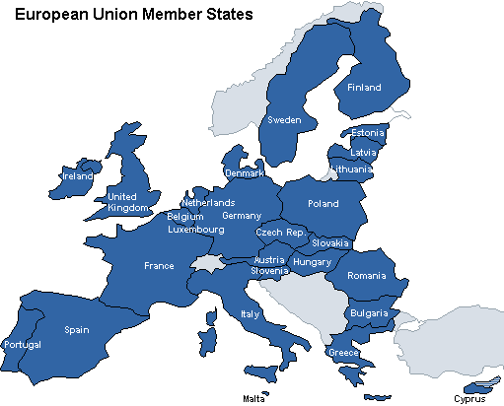
European Union

Slide 16
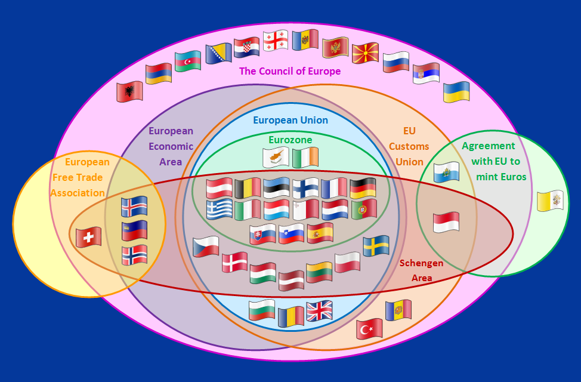
The EuroZone
The Economic Union is the BIG union of many European countries.
BUT there are many of those…

Slide 17
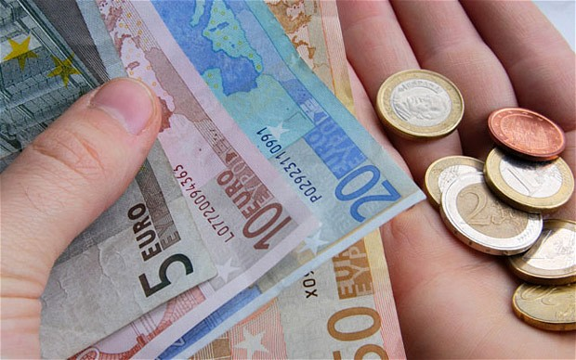
What the EuroZone is…
A geographic and economic region that consists of all the European Union countries that use the euro as their national currency.
Currently, there is a crisis with the EuroZone.
https://www.youtube.com/watch?v=aS6tNw3xi2o OR https://www.youtube.com/watch?v=SwsxJ4PSpO0

Slide 18
The most important things about the EuroZone…
Member countries share one currency: the Euro.
A European Central Bank located in Germany is in charge of making sure inflation is kept down.
Today, MANY countries in the EuroZone have increasing debts.
Most countries’ debt exceeds (is more) their GDP.
The “rescue packages” the EuroZone has given its indebted members have left it with a debt in the TRILLIONS (10 and more)!

Slide 19
EuroZone

Slide 20
Remember NAFTA?
NAFTA (North American Free Trade Agreement)= an agreement, implemented on Jan. 1, 1994, among the United States, Canada and Mexico designed to remove tariff barriers between the three countries.
NAFTA’s purpose is to encourage economic activity between the United States, Mexico and Canada by phasing out numerous tariffs, especially those related to agriculture, textiles, and autos.
The United States, Canada and Mexico have all experienced economic growth, higher wages and increased trade with each other since NAFTA’s implementation.

Slide 21
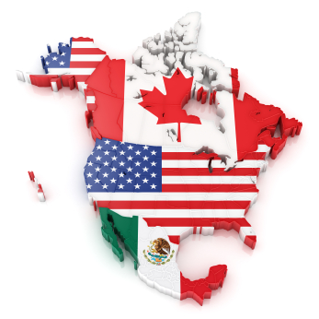
North American Free Trade Agreement

Slide 22
Today’s Assignment: Venn Diagram
Commonalities
North American Free Trade Agreement (NAFTA)
EuroZone

Slide 23
Writing Assignment
On the back of your Venn Diagram, you have room for an essay.
You will need to compare and contrast the Eurozone and NAFTA.
Paragraph 1: Introduction – name 2 differences and 1 similarity.
Paragraph 2: Difference #1and explain.
Paragraph 3: Difference #2 and explain.
Paragraph 4: Similarity and explain.
Paragraph 5: Is the Eurozone better than NAFTA? Is NAFTA better than the Eurozone? Use your differences and similarities to support your opinion.

Slide 24
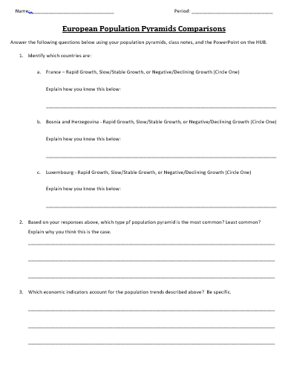
When you’re done…

Slide 25
Exit Ticket
Predict which economic union (EuroZone or NAFTA) is the most effective.

Slide 26
Extra Credit Video
https://www.youtube.com/watch?v=O37yJBFRrfg
The European Union Explained *

